Slide 1

Weekly Progress
GE1.02 Shang-Wei Chang
2025/1/30

Slide 2
Content
New Core Features
  Yawn Detection
  Head Pose Estimation
Technical Fixes & Optimization
  Auto-Calibration System
  Robust Euler Math for Head Pose
  Performance Cleanup
  HUD Visualization

Slide 3
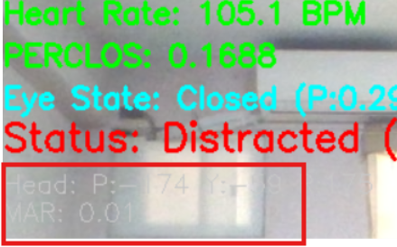
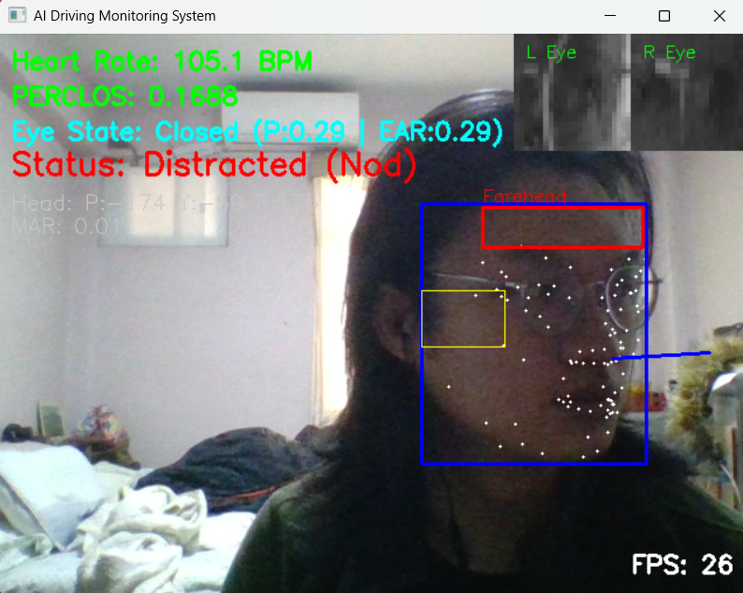
New Core Features
Head Pose Estimation: Integrated 3D pose tracking using `solvePnP`. The system now detects Pitch (nodding), Yaw (turning), and Roll in degrees.
Yawn Detection: Implemented Mouth Aspect Ratio (MAR) logic using inner lip landmarks to trigger a "YAWNING!" alert.
Distraction Logic: Added automated triggers that flag the user as "Distracted" if the head orientation deviates significantly from the center.

Slide 4
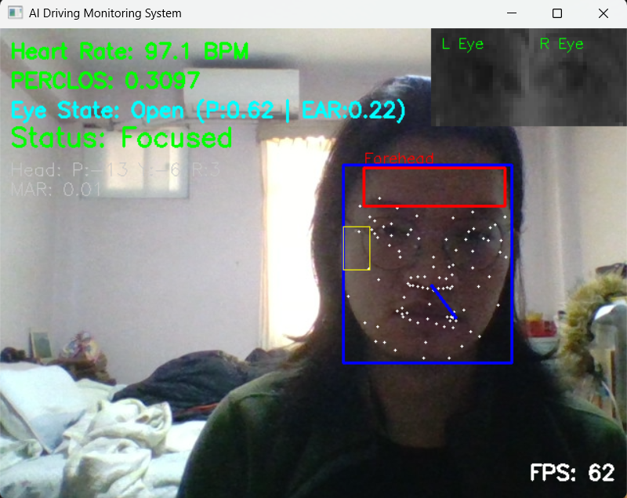
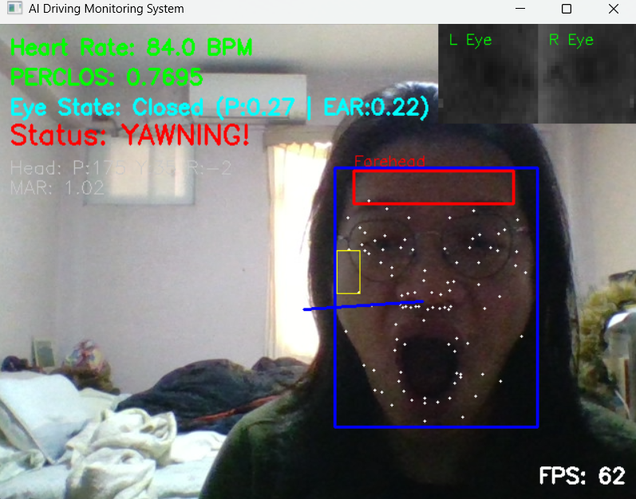
Different Status

Slide 5
Technical Fixes & Optimization
  Auto-Calibration System: Developed a startup routine that samples the first 60 frames to "Zero" the head pose, allowing for different camera angles and laptop tilts.
  Robust Euler Math: Replaced version-dependent OpenCV decomposition with a robust manual trigonometric calculation for rotation angles.
    Rotation Matrix To Euler Angles
    Computing Euler angles from a rotation matrix
  Performance Cleanup: Optimized the main loop and removed redundant debug logging to resolve "Not Responding" UI hangs.
  HUD Visualization: Added a 3D "Nose Vector" line to the face mesh to visually indicate gaze direction.

Slide 6
Thank you for listening
Q&A session

